Slide 1
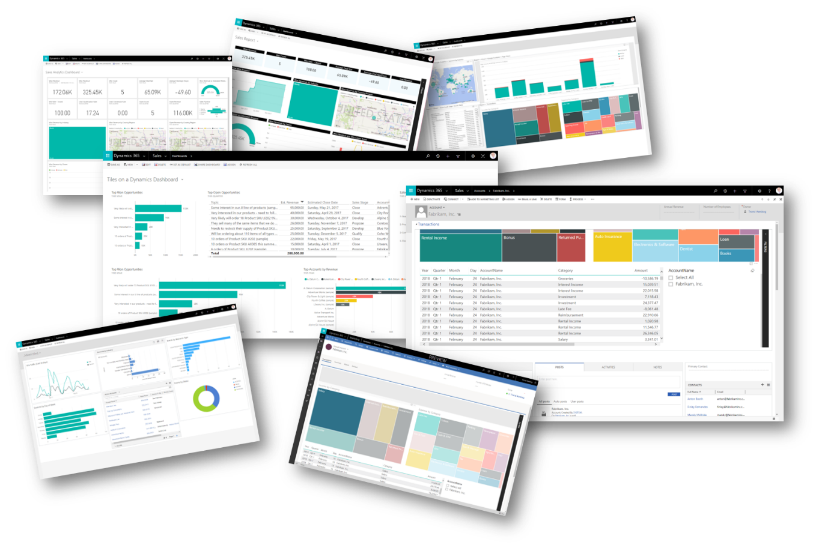
Power BI Report: Sales Insight
Nikhil Kuber Mankapure
nikhil.mankapure.tech@gmail.com
https://github.com/NikhilMankapure/Sales_insight-PowerBI-.git

Slide 2
Executive Summary:
Introduction: AltiQ Hardware is a brand that deals with the sales of computer parts and peripherals. And operate in various regions, mostly across India. They have stores across categories like Surge, excel, nomad, electrical sara stores. They majorly operate in 14 markets in India.
Mumbai
Bhopal
Delhi NCR
Hyderabad
Lucknow
Kanpur
Chennai
Nagpur
Ahmedabad
Bengaluru
Patna
Bhubaneshwar
Kochi
Surat
Markets
Problems
Sales Tracking Issues
Declining sales
Misleading Reports
Declining sales intpretation

Slide 3
Methodology
AIMS GRID
SQL Dump File to MySQL
MySQL Database Insights
Connecting MySQL to Power BI
Data Wrangling using power query
Dash-Board Building in Power BI
Sales Insights Summary

Slide 4
AIMS GRID:
A project management tool with four components
Purpose
Stake-Holders
End-Results
Success-Criteria
Purpose: Identify the pain points to the organization.
Stake-Holders: Integrating Various stake-holders for problem solving.
End Results: A dashboard, a concrete thankful result need to be determined.
Success Criteria: To improve the cost saving and save time. Realize the cause for the alarming reduction in revenue and identifying the places majorly witnessing drop.

Slide 5
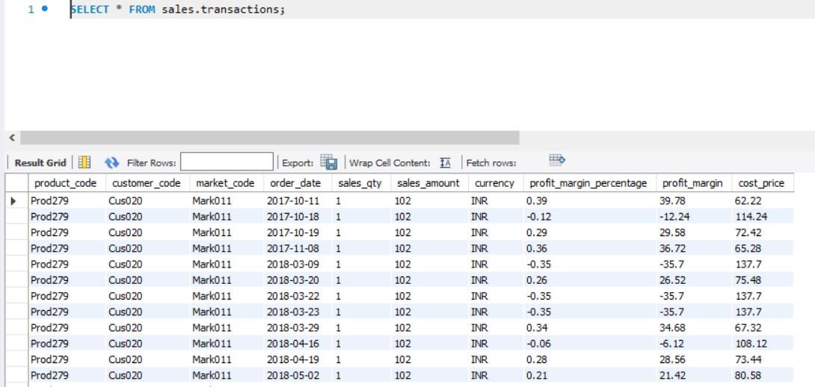
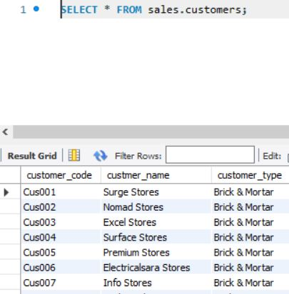
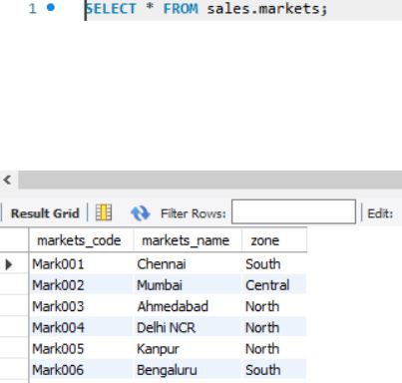
SQL dump file to MySQL
Steps to Upload dump file and query.
MySQL workbench > In navigator go to administration > Data Import
The file appears in the schema tab of navigator.

Slide 6
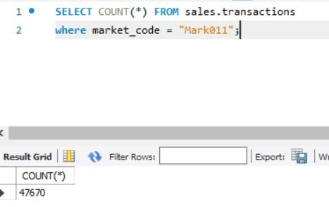
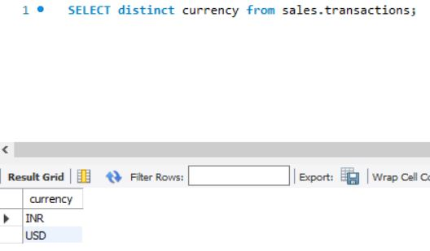
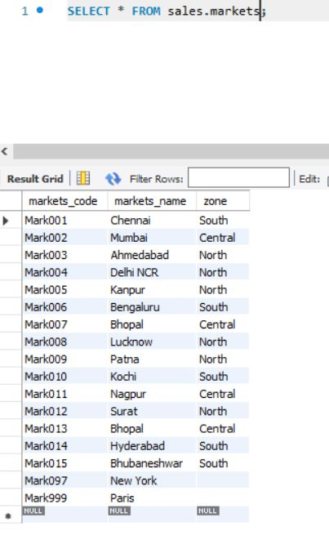
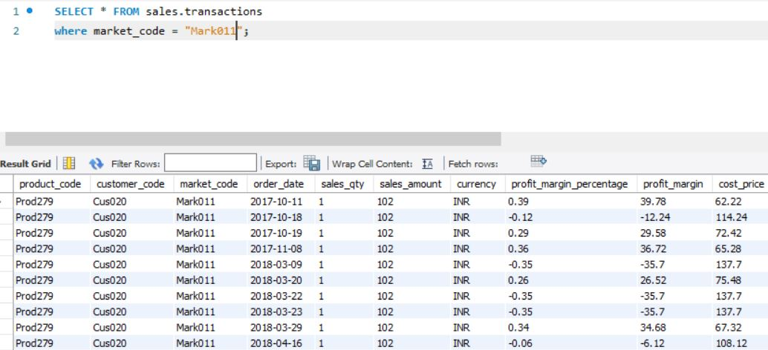
MySQL Database Insights
Various Queries are run to get insights from the database.

Slide 7
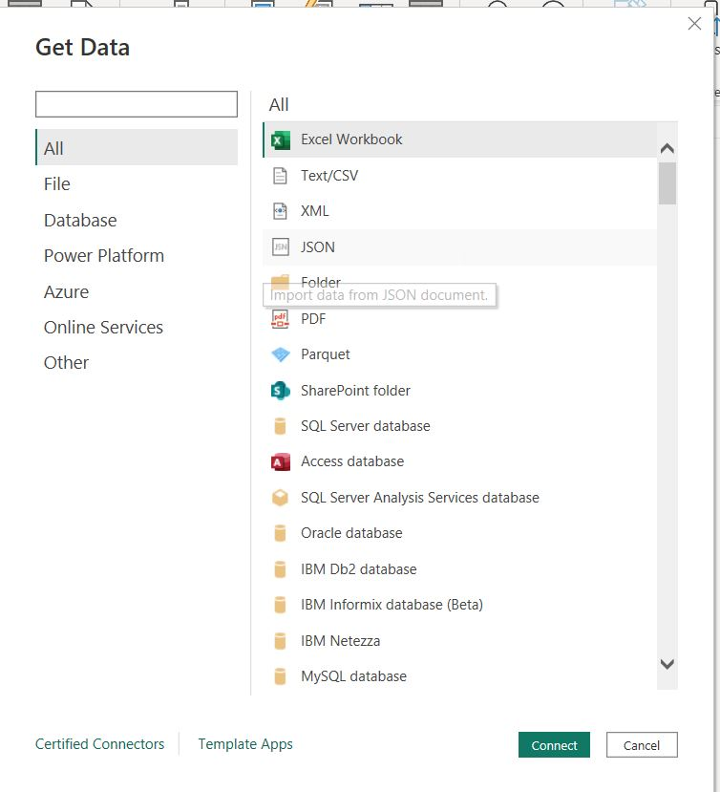
Connecting MySQL to Power BI
From the GET DATA option in the home tab in powerBI we import the data from MySQL by connecting the data base using the required credentials of our data base.

Slide 8
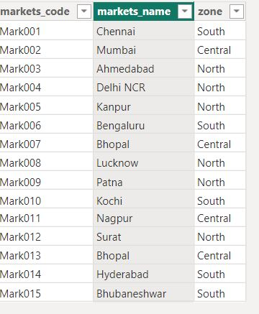
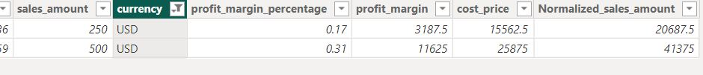
Data Wrangling
Opened the data base in Power Query tab.
Checked for the data types
Checked for the duplicate values in each table.
Changed the currency from USD to INR with conversion factor.
Cleaned the market for only the Indian Markets.

Slide 9
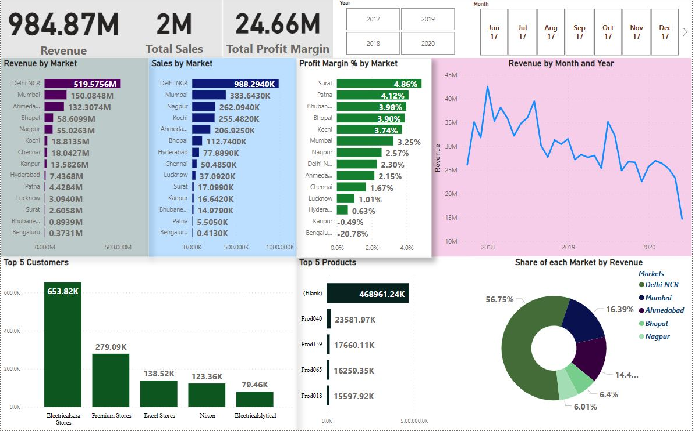
Dash Board Building
Dash Board requires some elements at its core: Total Revenue, Total Sales, Total Profit, Revenue by Market, Sales by Market, Top Customers, Top Products, etc.

Slide 10
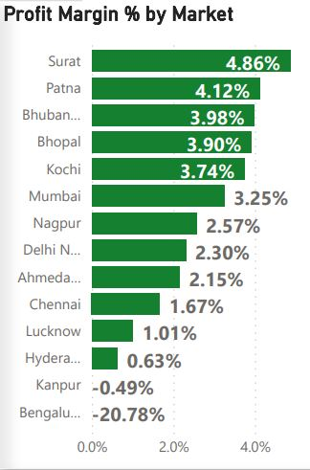
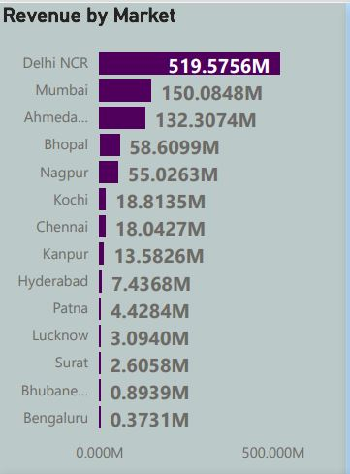
Sales Insight Summary:
Delhi is high on revenue, which tells us that it is the biggest market for ALtiQ
Delhi is the largest market but when it comes to profit margins the largest market has got
Surat is by far making most profits but the market size is significantly small. Bhopal is also having a good profit margin with a good market size and proving to be a great market overall.

Slide 11
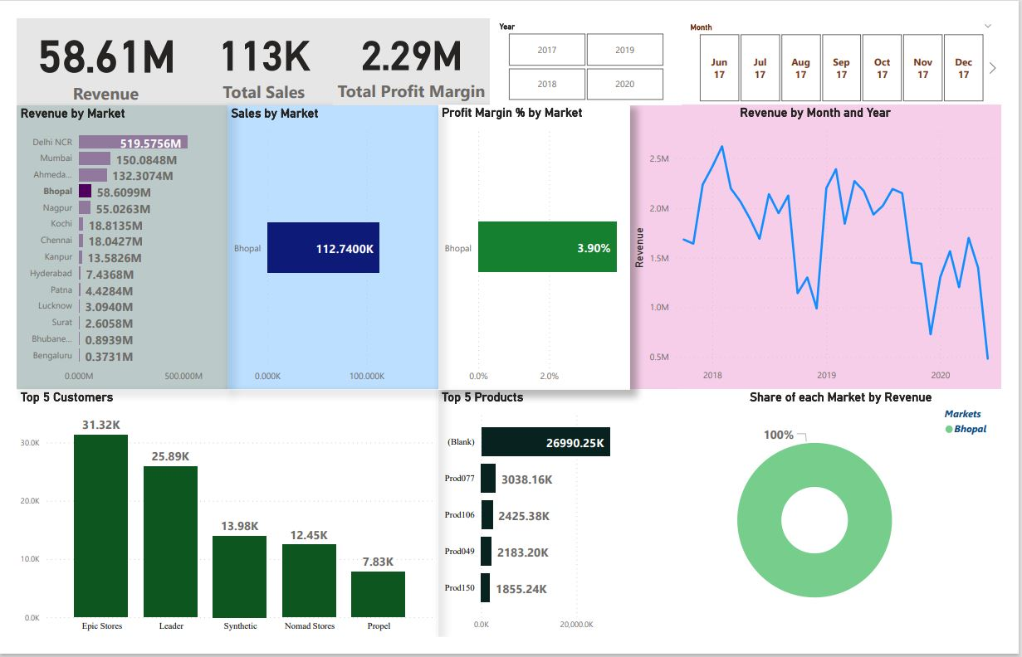
Bhopal Sales Insights
The revenue is declining year by year.
The top products are Prod077, Prod106, Prod049, Prod150.
Profit Margins are 3.90% as average of 3 years.

Slide 12
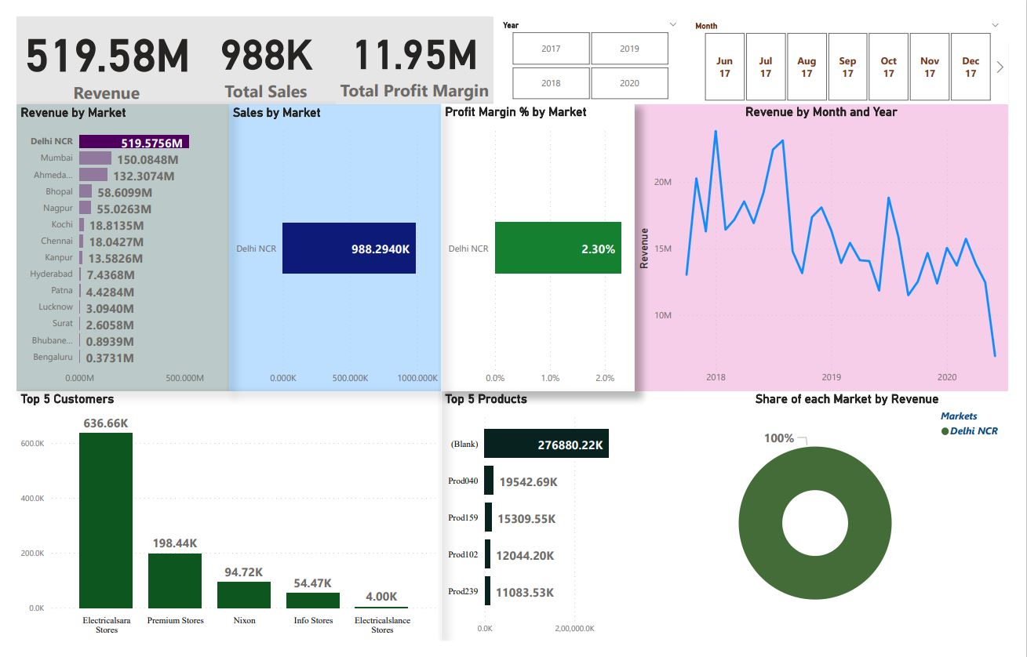
Delhi Insights
Revenue of 519.58M.
Declining Sales since 3 years.
Profit margin of merely 2.30%.
Top products are Prod040, Prod159, Prod102, Prod239.
Huge difference between the store no. 1 and the store no. 2. Increasing the sales from the other stores is important.
Store one strategy is to be understood for their market capturing.

Slide 13
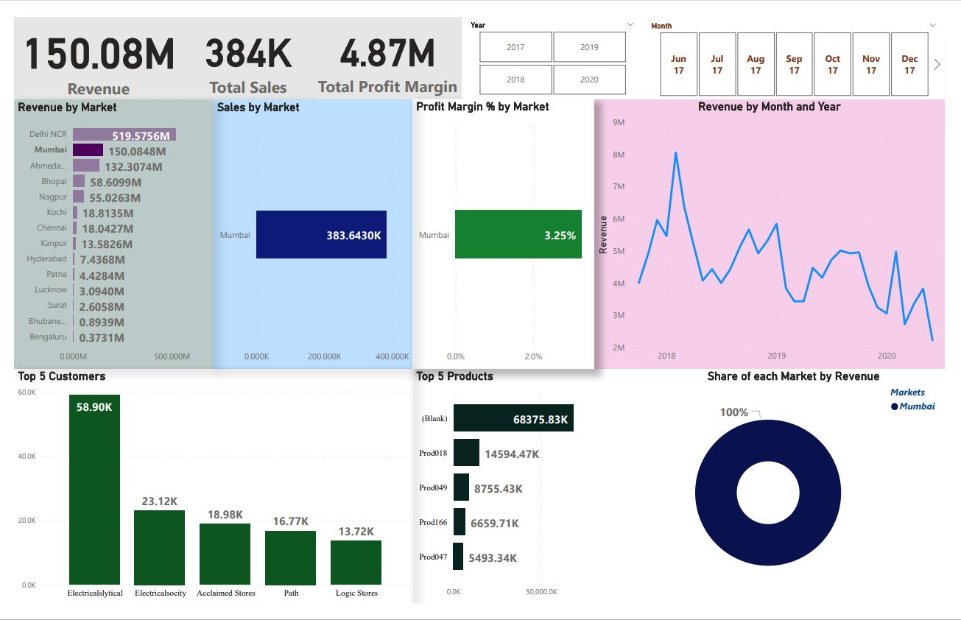
Mumbai Insights
Second largest market by Revenue.
Profits margins are significantly good i.e. 3.25%.
Electricalslytical is making a huge contribution to the total revenue.
Again focusing on other stores sales strategy to increase market capturing will enhance the total sales.
The overall revenue is declining year by year.

Slide 14
Conclusion:
The market analysis shows that the company has been impacted with the dynamically growing market and the solutions that appears through the analytical study is that,
Though the profit margin of Delhi NCR is slightly low but it has made huge revenue and it indicates that the major products sold there are considerably proving to be at better price than the competitor's product.
So one strategy is clearly indicated that we can reduce the profit margins thus reducing the price that can increase the sales for the products and sell better than the competitors.
Another strategy to be adopted is to focus on store strategy that is adopted by the top selling store and training the other stores on the similar lines.
There are immense more strategies which can be listed out through the insights and can be discussed with the stakeholders and a final strategy can be passed to improve the sales numbers.

Slide 15
THANK YOU
Special Thanks To Codebasics: DataAnalysisProjects/1_SalesInsights at master · codebasics/DataAnalysisProjects (github.com)
For providing with the files for the analysis and guiding me through the project.

